Slide 1

Building and Mining Knowledge graphs
(KEN4256)
Lecture 3: Constructing a Knowledge Graph from
Unstructured Data

Slide 2
© 2024 by Michel Dumontier and the Institute of Data Science at Maastricht University is licensed under Attribution 4.0 International
To view a copy of this license, visit http://creativecommons.org/licenses/by/4.0/
This license requires that reusers give credit to the creator. It allows reusers to distribute, remix, adapt, and build upon the material in any medium or format, even for commercial purposes.
id: KEN4256_L3
version: 1.2024.0
created: February 2, 2019
last modified: March 26, 2024
published on: March 26, 2024

Slide 3
Introduction
Knowledge in the form of natural language (e.g. text) offers a rich source of information for answering questions.
Text is not easily processable by machines in the sense that the program will fully understand what is stated.
Natural language processing (NLP) can be used to make the semantic content of text processable by machines.

Slide 4
From text to (RDF) graph
Albert Einstein was a German-born theoretical physicist who developed the theory of relativity.
recognize the entities and relations (named entity recognition & relation extraction)
map to identifiers (entity/relation linking)
project to target schema
occupation
Theoretical
Physicist
Albert Einstein
born in
Germany
developed
Theory of relativity

Slide 5
NLP
(classic) NLP involves a pipeline with some or all of the steps:
tokenisation: segment text into words, punctuation, tokens
normalisation: transforms abbreviations, slang, upper/lower case, etc. into a standard form
stopword removal. remove common words e.g. the, or, of
stemming & lemmatisation. replace words such as "build", "builds", "build", "buildler", and "building" with the same word (and stem) "build"
parts of speech (PoS) tagging. assign word types to tokens such as nouns, verbs, adjectives, and adverbs.
dependency parsing: find relations between parts of speech

Slide 6
Named Entity Recognition
NER is a task of assigning one of pre-defined types to each word/word phrase in the text.
Albert Einstein was a German-born theoretical physicist who is best known for developing the theory of relativity. In 1905, he was awarded a PhD by the University of Zurich and received the 1921 Nobel Prize in Physics "for his services to theoretical physics.
[PER Albert Einstein] was a [LOC German]-born theoretical physicist who is best known for developing the theory of relativity. In [TIME 1905], he was awarded a PhD by the [ORG University of Zurich]and received the [TIME 1921] Nobel Prize in Physics "for his services to theoretical physics.

Slide 7
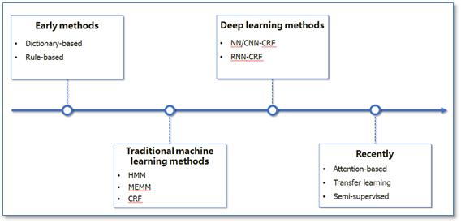
NER Methods
Early Methods
Dictionary-based
Rule-based
Traditional Machine Learning
HMM / CRF / MEMM
Deep Learning
CNN/RNN CRF
Attention-based
Transfer Learning
Image: https://www.programmersought.com/article/48534259085/

Slide 8
Approaches to NER
Dictionary-based
use a pre-defined dictionary of terms to find exact matches in the text.
include synonyms and misspellings to increase recall
Rule-based
Express the extraction rules in a formal rule language
Regular expressions, such as address (city + province + country…)
References to dictionary
Invoke custom extractors

Slide 9
Approaches to NER
Language Models
Task-independent training
Train the model on the domain of interest
Task-dependent training
Introduce special tags in the input

Slide 10
BERT : Bidirectional Encoder Representations from Transformers
Bidirectional - look back and forward in a sentence to understand the meaning
Transformers - The Transformer reads entire sequences of tokens at once. A transformer architecture is an encoder-decoder network that uses self-attention on the encoder side and attention on the decoder side. The attention mechanism allows for learning contextual relations between words.
(Pre-trained) contextualized word embeddings - Encode words based on their meaning/context.
in 2018, BERT showed state of the art performance for a number of tasks such as natural language inference, sentiment analysis, question answering, paraphrase detection, linguistic acceptability

Slide 11
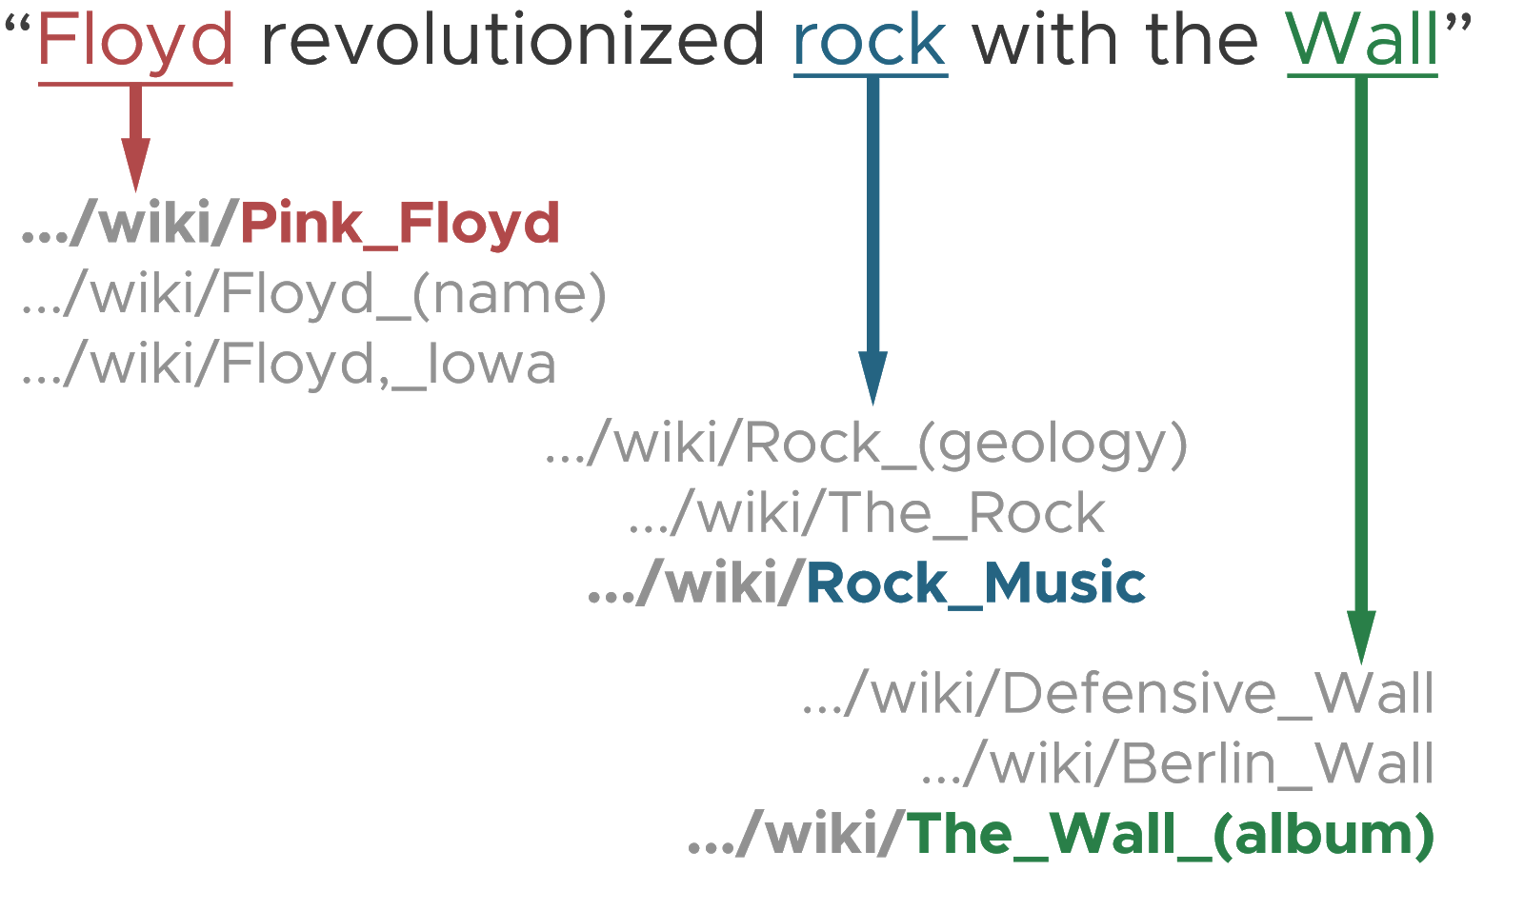
Named Entity Linking
NEL is the task of linking entity mentions with their corresponding objects in a target database/ontology.

Slide 12
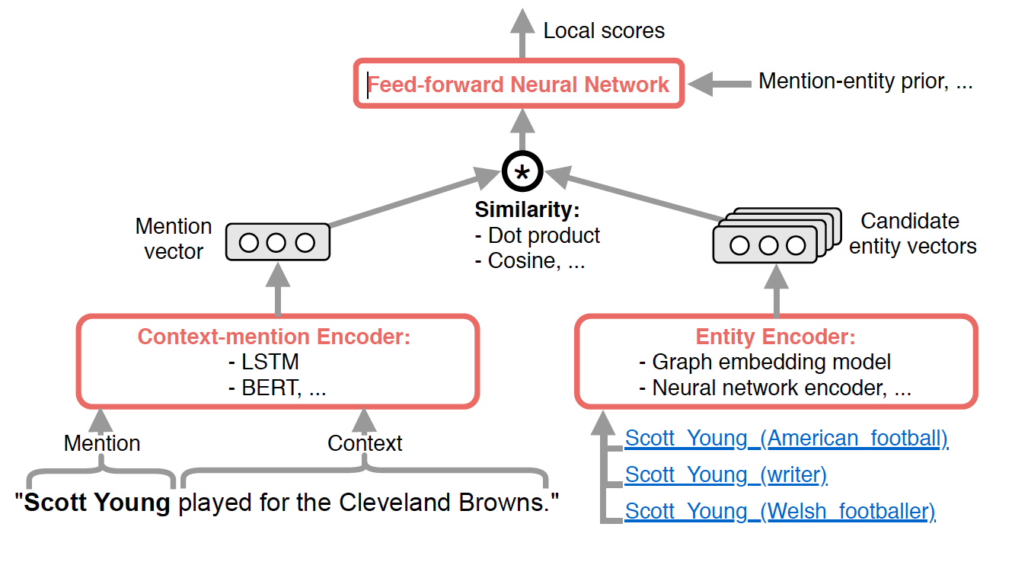
NEL Methods
Syntactic
Semantic
Contextual
Embedding

Slide 13
Challenges in NER and NEL
Ambiguity
Louis Vouitton—can be company, person, or product
Training data
Data is usually small and incomplete
Domain-specific Variations
Michael Jordan -> MJ, Michael Jeffrey Jordan
Many different forms of an entity
Need to have a lexicon

Slide 14
Relation Extraction
RE is the task of identifying relationships between entity mentions.
Albert Einstein was a German-born theoretical physicist who is best known for developing the theory of relativity. In 1905, he was awarded a PhD by the University of Zurich and received the 1921 Nobel Prize in Physics "for his services to theoretical physics.
Albert Einstein born in Germany
Albert Einstein occupation Theoretical physicist
Theoretical physicist branch of Physics
……

Slide 15
Approaches to Relation Extraction
Syntactic patterns (or rule-based)
To discover pattern for a new relation, collect several examples of that relation
Look for generalities to discover new patterns
The Netherlands has many well-known universities, such as Maastricht University, having strong research capabilities.
Even though we have never heard of Maastricht University,
but we can extract that it is a kind of well-known university

Slide 16
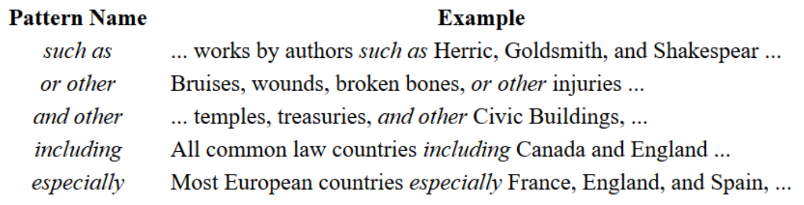
Approaches to Relation Extraction
Syntactic patterns (or rule-based) (known as Hearst Pattern)

Slide 17
Approaches to Relation Extraction
Supervised learning
Requires a huge amount of training data
We can use syntactic patterns to generate training data
We can write approximate labelling functions

Slide 18
Challenges in Relation Extraction
Open information extraction
Does not rely on a designed set of relations
Can be difficult to use/understand the relations
N-ary relation
N-ary relations involve more than two entities
Requires complex methods and high-quality data
Albert Einstein
was awarded
Nobel Prize in Physics
1921

Slide 19
NLP Tools
Many tools for information extraction have been released.
Named Entity Recognition
StandfordNER
OpenNLP
SpaCy
NLTK
Named Entity Linking
DBPedia Spotlight
CoNEREL
Relation Extraction
CiceroLite
FOX
Open Calais

Slide 20
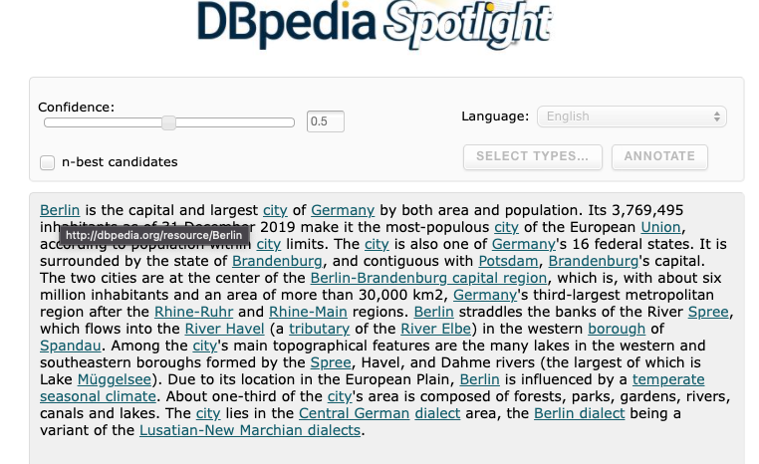

Slide 21

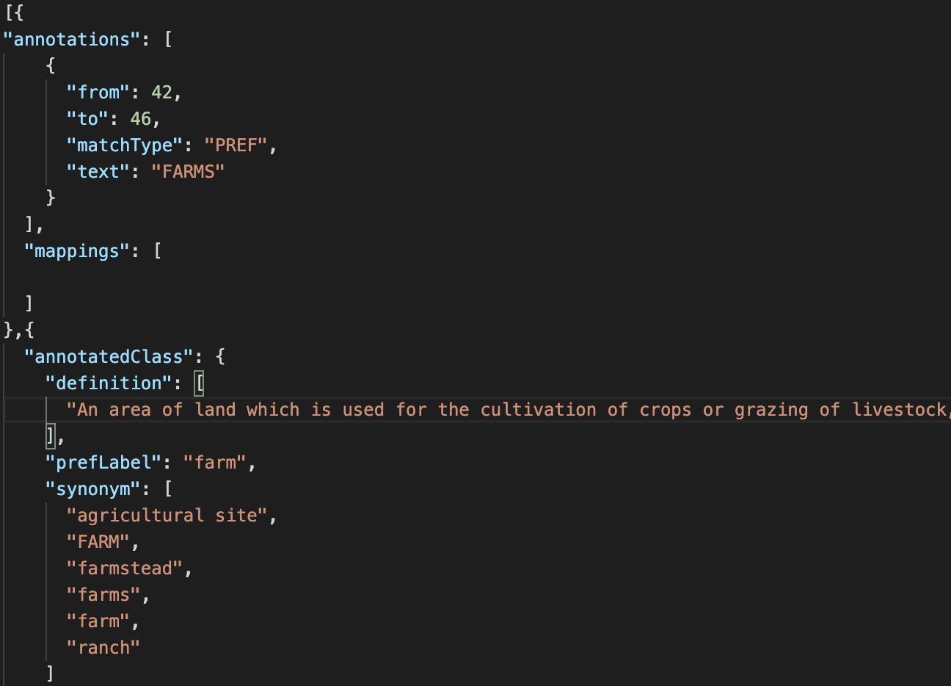
AgroPortal & BioPortal

Slide 22
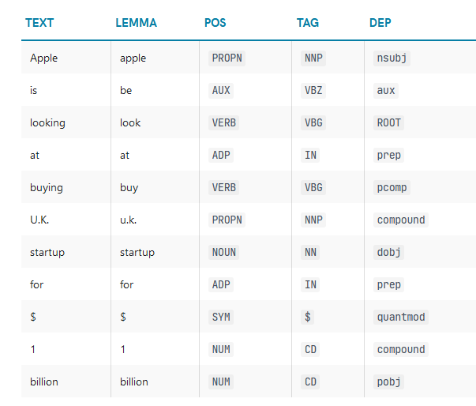
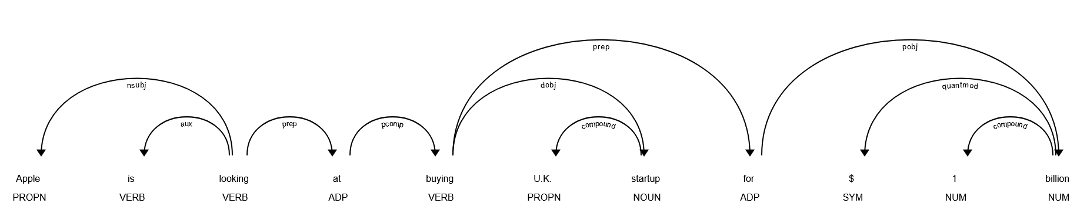
spaCy
!python -m spacy download en_core_web_sm
import spacy
nlp = spacy.load('en_core_web_sm')
doc = nlp("Apple is looking at buying U.K. startup for $1 billion")
for token in doc:
print(token.text, token.lemma_, token.pos_, token.tag_, token.dep_)
spaCy is a free, open-source library for advanced Natural Language Processing (NLP) in Python. https://spacy.io
from spacy import displacy
displacy.serve(doc, style="dep")

Slide 23
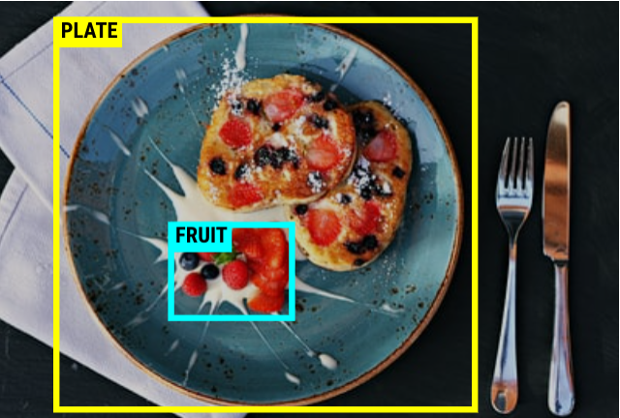
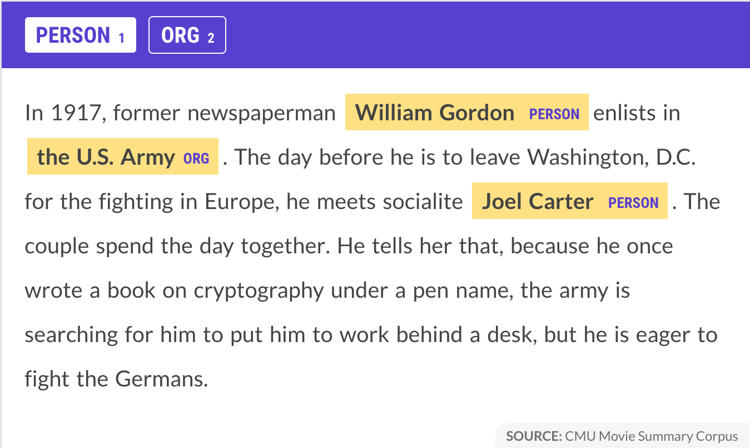
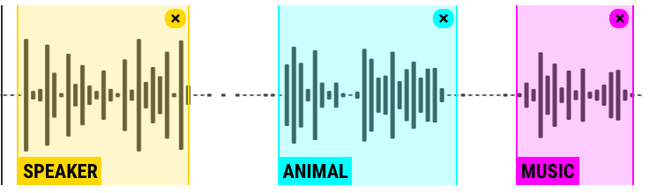
Prodigy
For creating training and evaluation data for machine learning
Python library + web UI
‘Fast, intuitive and efficient annotation’

Slide 24
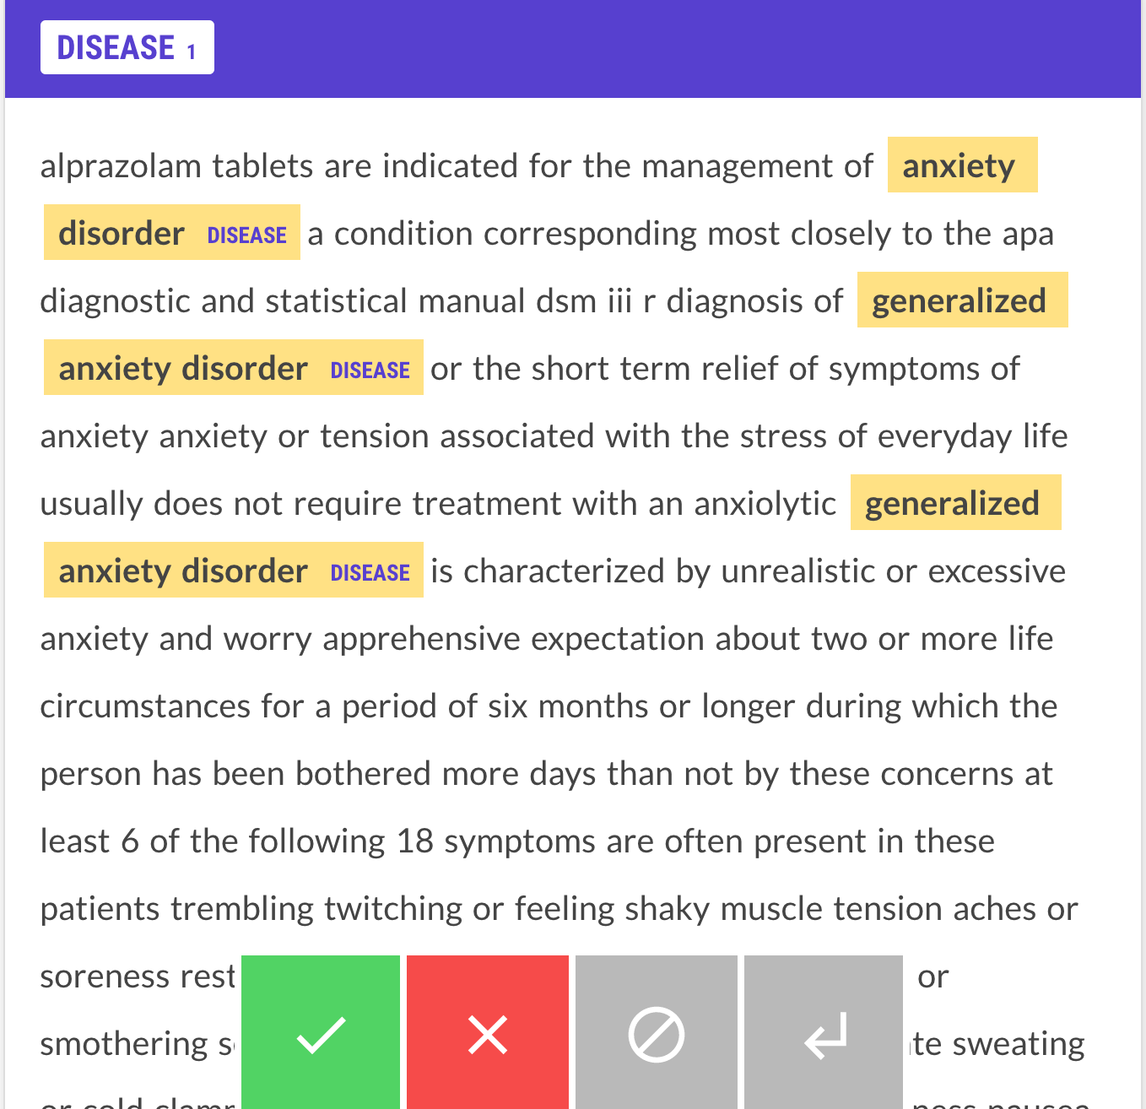
Named Entity Recognition

Slide 25
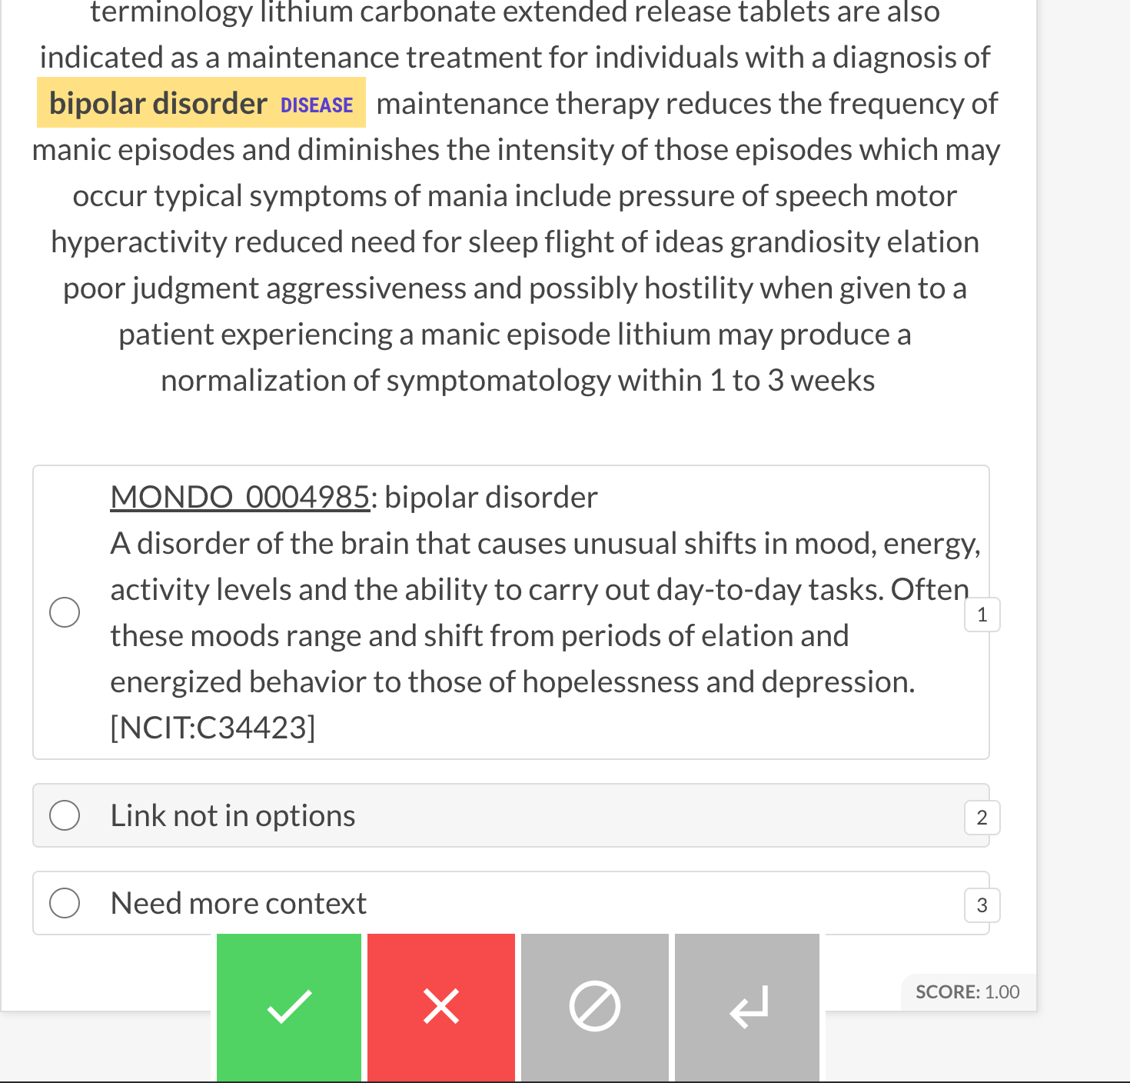
Named Entity
Linking

Slide 26
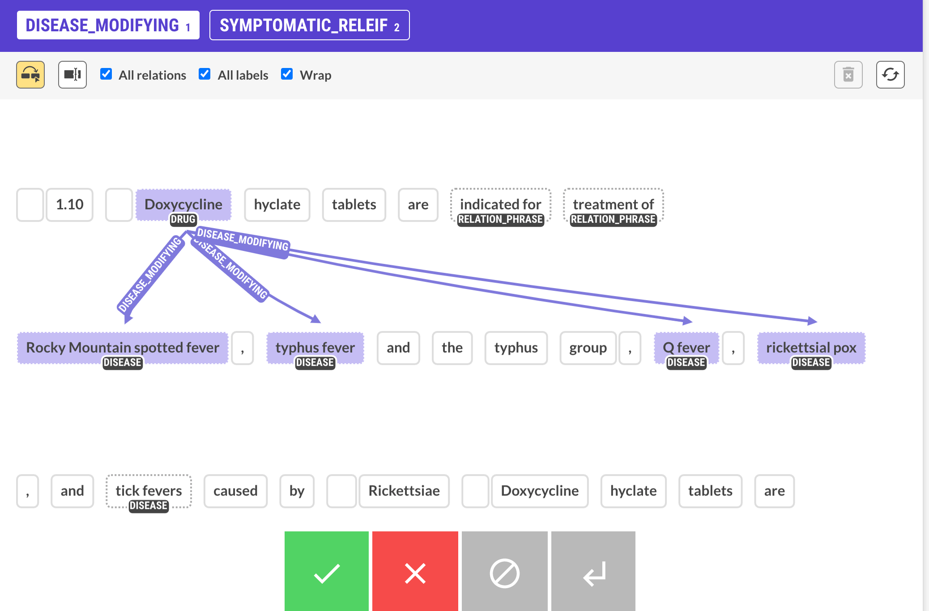
Relation Extraction

Slide 27
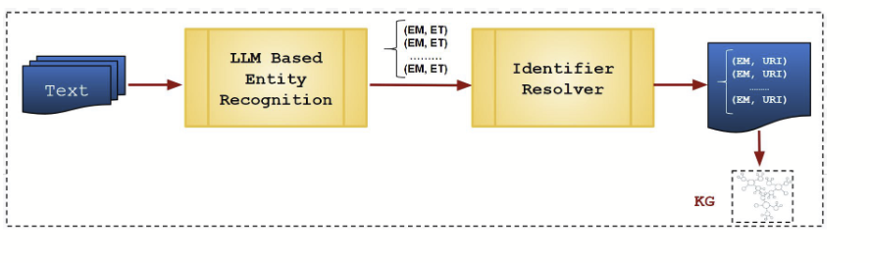
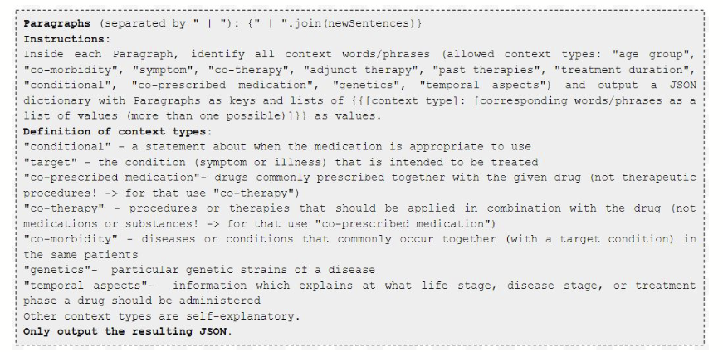
LLM-powered graph construction
prompt an LLM to extract the entities
use a tool to assign the identifier
construct the graph

Slide 28
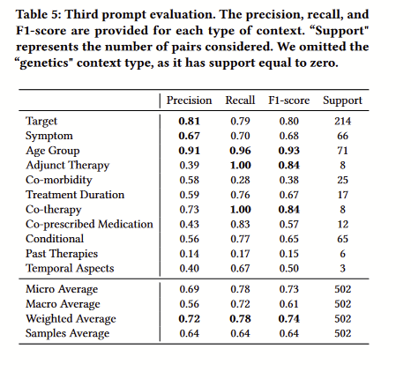

Slide 29
Summary
Entity and relation extraction are fundamental problems to creating knowledge graphs from text
Use of rule-based methods for training data generation that can be fed into pre-trained language models is becoming an increasingly popular paradigm
Entity linking and resolution will eventually play an important role

Slide 30
Questions?

